Slide 1

Regex Matching Web App Development

Slide 2
About me
As a B.Tech student majoring in Electronics and Communication Engineering (ECE) at Rajiv Gandhi University of Knowledge Technologies, I've refined my proficiency in mathematics, programming, and analytical thinking. Despite my specialization in ECE, I am deeply intrigued by the potential of data science to glean valuable insights from extensive datasets, fostering innovation and informed decision-making. To augment my skills, I have actively pursued supplementary coursework and engaged in self-directed study in data science, completing various online courses, participating in hackathons, and undertaking personal projects.
Although I lack formal employment experience in data science, I have independently executed projects and contributed to academic endeavors centered around data analysis and machine learning. These hands-on experiences have effectively merged theoretical knowledge with practical application, thereby enhancing my problem-solving prowess. For further details regarding my academic background, projects, and skill set, I invite you to explore my LinkedIn profile (https://www.linkedin.com/in/dileepmanelli/ )and GitHub repository ( https://github.com/dileepmanelli ).

Slide 3
Objective of the project
The Objective of the Project is to develop a user-friendly web application for regex matching.To understand the practical implementation of regular expressions in web development.
Importance of Regular Expressions: Regular expressions are powerful tools for pattern matching and text processing.They are widely used in various fields including data validation, text search, and data extraction.
Importance of Web Applications for Regex Matching: Web applications provide accessibility and ease of use, allowing users to utilize regex matching functionalities without installing additional software.

Slide 4
Project Description
Description of the Regex Matching Web App:The web app is built using Flask, a Python web framework, facilitating rapid development and deployment.
Functionality Overview:Users input a test string and a regular expression via a simple HTML form.The server-side Python code processes the input and performs regex matching using the re module.Matched strings are displayed to the user.
Technologies Used:
Flask: Lightweight web framework for Python.
HTML: Markup language for creating web pages.
CSS: Styling language for enhancing the appearance of web pages.
Importance of Virtual Environment Setup: Virtual environments ensure project dependencies are isolated, facilitating reproducibility and avoiding conflicts with system-wide packages.

Slide 5
Implementation Details
Directory Structure:
Project directory contains:
app.py: Python file defining Flask application and routes.
templates directory: Contains HTML templates (index.html, results.html).
app.py: Contains Flask application setup and route definitions.
HTML Templates:
index.html: Form for inputting test string and regex pattern.
results.html: Displaying matched strings.
Flask Routing Explanation:Routes defined to handle different URL paths and HTTP methods.
HTML Form Design Explanation:Form elements for user input with appropriate labels and styling.
Regular Expression Matching in Python:Utilizing the re module for regex matching within the Python environment.Handling Form Submission and Displaying Results:Retrieving form data using Flask's request object.Displaying matched strings using HTML templating.

Slide 6
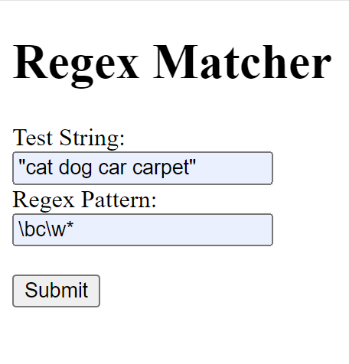
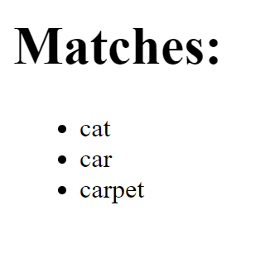

Slide 7
Deployment on AWS EC2
Overview of AWS EC2:
Elastic Compute Cloud (EC2) provides scalable virtual servers in the cloud.
Benefits of EC2 for Web Application Deployment:
Scalability: Ability to scale resources based on demand.
Flexibility: Various instance types and configurations available.
Accessibility: Accessible from anywhere with an internet connection.
Steps for Deploying the Web App on EC2 Instance:
Setting Up EC2 Instance: Choosing instance type, configuring security groups, and launching instance.
Installing Dependencies: Installing Python, Flask, and other required packages.
Transferring Project Files: Uploading project files to EC2 instance.
Running the Application: Starting the Flask application on the EC2 instance.

Slide 8
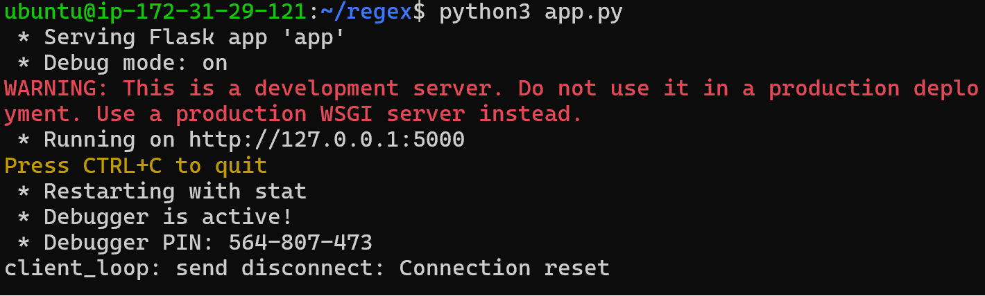

Slide 9
Challenges Faced
Potential Challenges in Web Application Development:
Dependency Management: Ensuring compatibility and resolving version conflicts.
Deployment Configuration: Configuring server settings for optimal performance and security.
Error Handling: Addressing potential errors and exceptions in the application.
Specific Challenges Faced During This Project:
Configuring AWS EC2 Security Groups: Ensuring correct network access permissions.
File Transfer to EC2 Instance: Transferring project files securely to the remote server.
Environment Setup on EC2: Installing and configuring Python and Flask in the EC2 environment.
Solutions Implemented to Overcome Challenges:Researching AWS documentation and community forums for guidance.Utilizing secure file transfer protocols like SSH and SFTP.Following best practices for environment setup and package installation.

Slide 10
Future Improvements
To Potential Enhancements for the Web App:
Error Handling: Implementing robust error handling mechanisms to provide informative feedback to users.
User Authentication: Adding user authentication features to secure access to the application.
Improved User Interface: Enhancing the design and usability of the web interface.
Performance Optimization: Optimizing code and server configurations for faster response times.
Scaling the Application for Higher Traffic:
Implementing load balancing and auto-scaling mechanisms to handle increased user traffic.Utilizing AWS services like Elastic Load Balancing and Auto Scaling to dynamically adjust resources.

Slide 11
Conclusion
Developed a Regex Matching Web App using Flask and deployed it on AWS EC2.
Demonstrated the practical application of regular expressions in web development.
Achievements of the Project:Successfully implemented a user-friendly interface for regex matching.Deployed the application on a scalable cloud infrastructure for accessibility.
Importance of Regex Matching Web Apps:
Provide users with a convenient way to utilize regex functionalities without installing additional software.
Future Prospects and Recommendations:
Continued development and enhancement of the web application based on user feedback and emerging technologies.

Slide 12
References
Github Link: https://github.com/dileepmanelli/Regex_webapp_AWS
Linkedin post URl: https://www.linkedin.com/posts/dileepmanelli_keyhighlights-innomaticsresearchlabs-datascience-activity-7170333252338081792-x6gy?utm_source=share&utm_medium=member_desktop
AWS deployment link: https://3.87.154.193:5000/

Slide 13

THANK YOU

